Slide 1






Built classifier to identify fake vs real news
Group 2
Fake News Detection
Using Machine Learning
Model: Triple Hybrid Ensemble
(NB + LR + FastText)
Final result: 95.58% test accuracy
Team
Rima, Domien, Dimi

Slide 2
















02
Project Overview
Project Overview
Goal
Classify news as fake (0) or real (1) and deploy
Hypothesis
Dataset
Fake vs real news use different language patterns/word choices
testing_data_lowercase.csv
Expected
Preprocessing and model choice to be the key drivers of accuracy

Slide 3

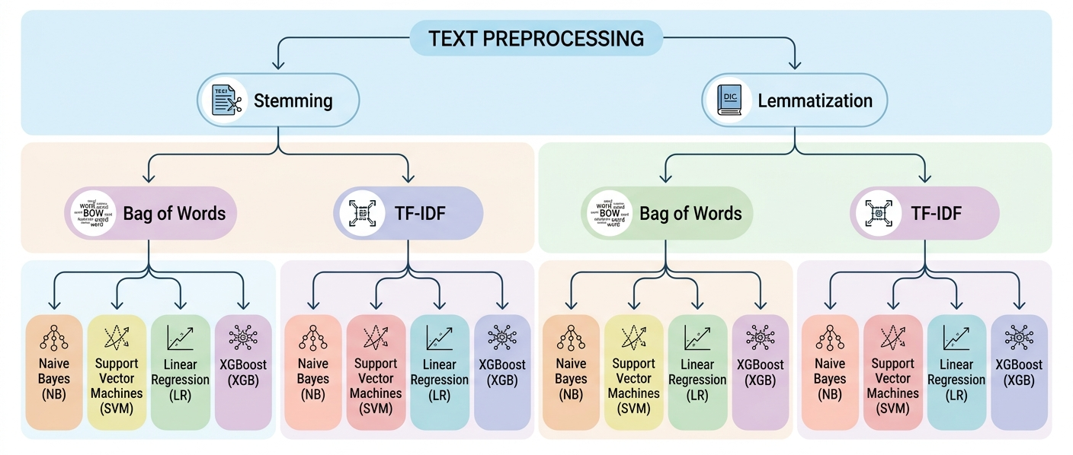
Model Selection Pipeline: From Preprocessing to Classification

Slide 4










Data Wrangling
04
Preprocessing Methods
Techniques tested and their application in the best performing models
Techniques Tested
Used in Best Models
Stopword removal
Punctuation removal
Number removal
Stemming
Lemmatization

Slide 5





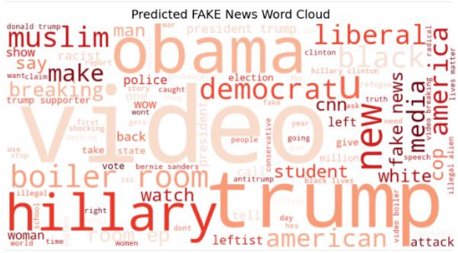
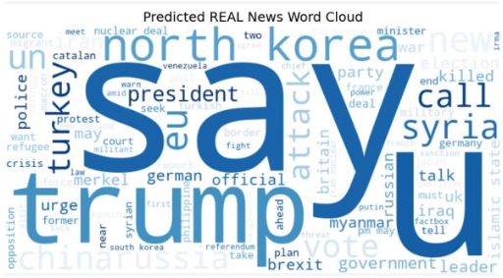
03
Exploratory Data Analysis
Word Cloud Analysis
Visualizing the most frequently used words in Fake and Real news datasets.
Fake News
Real News

Slide 6


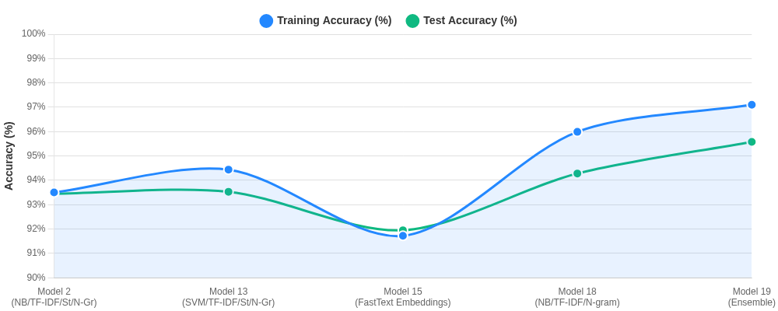
Model Comparison
Model Comparison
Training vs. Test Accuracy across different modeling approaches

Slide 7











Model Comparison
Best Models
Comparing the top 3 performing models. The Ensemble approach emerges as the clear winner.
Winner
Model 13
Model 18
Model 19
SVM
TF-IDF / St / N-Gr
Naive Bayes
TF-IDF / N-gram
Ensemble
Triple Hybrid
Train Accuracy
Train Accuracy
Train Accuracy
97.10%
94.44%
95.99%
Test Accuracy
Test Accuracy
Test Accuracy
95.58%
93.53%
94.28%

Slide 8




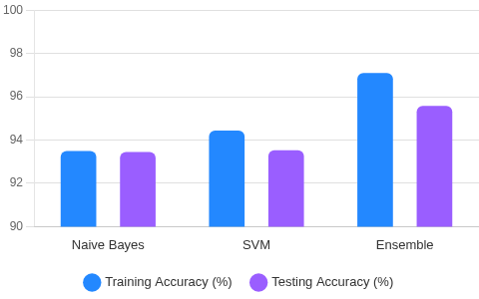

09
Testing Validation
Testing Validation
Accuracy: Training vs Testing
Testing Approach
Evaluated models using Accuracy and F1-score metrics.
Cross-Validation
Applied to ensure robust performance across data splits.
Train-Test Gap Analysis
Monitored differences to identify and prevent overfitting.
Generalization
Focused on real-world readiness over pure training scores.

Slide 9







Model Comparison
08
Winner Model
Triple Hybrid Ensemble
Combining statistical, linear, and semantic approaches for maximum robustness.
Multinomial
Naive Bayes
Logistic
Regression
FastText
Embeddings
Captures frequency-based patterns and keyword indicators.
Determines the weighted importance of specific terms.
Uses sub-word embeddings for deep semantic understanding.
Test Accuracy
Train Accuracy
F1-Score
Generalization Gap
95.58%
97.06%
0.9327
1.48%

Slide 10





Key Takeaways
Hypothesis supported: Fake vs real news use different language patterns/word choices
Key learning: Simple models are highly effective for text tasks.
Challenge: Selecting the optimal preprocessing for diverse model architectures.
Thank You!
Group 2 - Rima, Domien, Dimi

